Slide 1
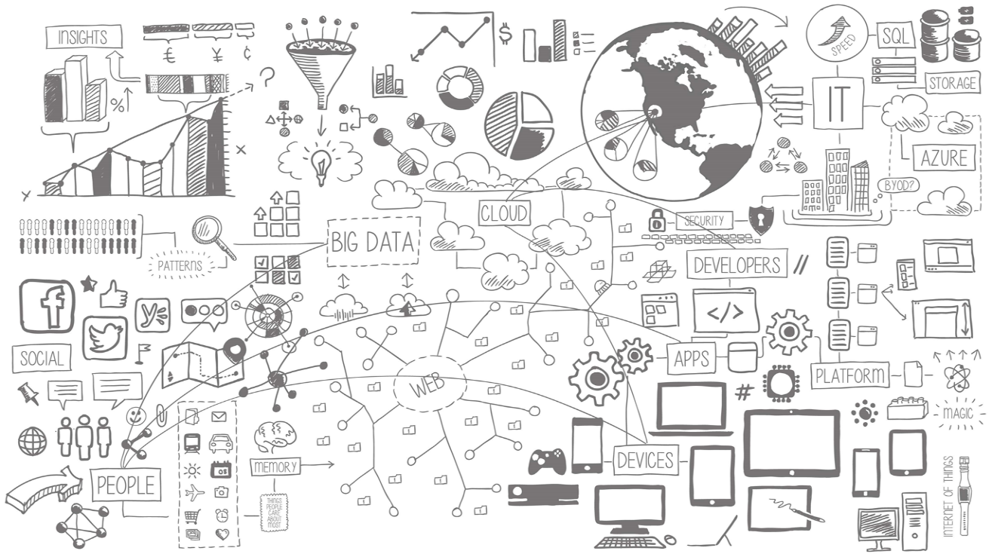

Big Data Blueprints – Reference Architectures for Big Data Implementations
George Corugedo
CTO, RedPoint Global Inc.
george.corugedo@redpointglobal.com
Notes:
According to the 2013 IDC study (The Digital Universe of Opportunities: Rich Data and the Increasing Value of the Internet of Things) the digital universe is doubling every two years
…and is expected to multiply by 10-fold between 2013 and 2020 – from 4.4 trillion gigabytes to 44 trillion gigabytes
The sheer volume of the world’s digital data would fill a stack of Surface 2 tablets extending two-thirds the distance to the moon. By 2020, this stack would extend from the earth to the moon 6.6 times due to the rate of data growth.
This explosion of data is impacting consumers and businesses at breakneck speeds. Succeeding in this data-intensive environment requires smart analysts and savvy executives that are able to distill enormous amount of data into (click) succinct INSIGHTS!
The revolutions in Microsoft’s BI tools have revolutionized the way that we can explore data and get to the right insights needed to drive impact in our organization.
My goal is to share how you can revolutionize the way that you explore and present data for your company. First, let me share a little about the journey that we’ve been on in the Finance division at Microsoft to drive impact in our company using our data….
Other data:
–currently, 60 per cent of data in the digital universe is attributed to mature markets such as Germany, Japan, and the United States, but by 2020, the percentage will flip, and emerging markets including Brazil, China, India, Mexico and Russia will account for the majority of data;
–this year less than 20 per cent of the data was “touched” by the cloud. By 2020, that percentage will double to 40 per cent;
–this year 18 per cent of data will be generated by mobile devices (include RFID tags, GPS devices, smart cards, cars, toys and dog collars). By 2020 that will be 27 per cent;
–two-thirds of the digital universe bits are created or captured by consumers and workers, yet enterprises have liability or responsibility for 85 per cent of the digital universe.
Read more: http://www.itworldcanada.com/article/the-amount-of-data-were-creating-is-out-of-this-world/91586#ixzz3MJ1Fk5Hp or visit http://www.itworldcanada.com for more Canadian IT News
The amount of information in the digital universe would fill a stack of iPad Air tablets reaching 2/3 of the way to the moon (157,674 miles/253,704 kilometers). By 2020, there will be 6.6 stacks.
Today, the average household creates enough data to fill 65 iPhones (32gb) per year. In 2020, this will grow to 318 iPhones
Today, if a byte of data were a gallon of water, in only 10 seconds there would be enough data to fill an average house. In 2020, it will only take 2 seconds.

Slide 2



















































Platform Services
Security & Management
Compute
Web and Mobile
Developer Services
Hybrid
Operations
Cloud
Services
Service
Fabric
Web Apps
API
Apps
API
Management
Visual Studio
Azure SDK
Portal
Azure AD
Connect Health
Batch
Remote App
Mobile
Apps
Logic
Apps
Notification
Hubs
Team Project
Application
Insights
Active
Directory
AD Privileged
Identity
Management
Multi-Factor
Authentication
Integration
Analytics & IoT
Data
Backup
Storage
Queues
Biztalk
Services
Automation
HDInsight
Machine
Learning
SQL
Database
SQL Data
Warehouse
Operational
Insights
Hybrid
Connections
Service
Bus
Key Vault
Data
Factory
Event
Hubs
Redis
Cache
Search
Import/Export
Store /
Marketplace
Media & CDN
Site
Recovery
Stream
Analytics
Mobile
Engagement
DocumentDB
Tables
VM Image Gallery
& VM Depot
Media
Services
Content Delivery
Network (CDN)
StorSimple
Infrastructure Services
Compute
Storage
Networking
Virtual Machines
Containers
BLOB Storage
Azure Files
Premium Storage
Virtual Network
Load Balancer
DNS
Express
Route
Traffic Manager
VPN Gateway
Application Gateway
Datacenter Infrastructure (34 Regions)
Notes:
Why this Slide:
It shows we have a very broad platform. It about BOTH IaaS and PaaS, that these work together. It shows that we continue to lead in world class IT capabilities and that there’s really nothing missing.
Key Points:
We have already seen how the Azure Platform is IaaS + Pass – but I want you to understand that this is a huge number of capabilities – IT building blocks if you will.
Every one of these blocks you provision anytime, self-service anywhere in the world 24x7. You pay for what you use, you can get more or less anytime and you can fully automate everything…
DON’T spent too much time on this slide – you are going to DEMO (aren’t you!!!)… DON’T go through each block…
Transition to NEXT Slide: Make the build go backwards to show JUST IaaS and then you will go to the demo to show it.

Slide 3
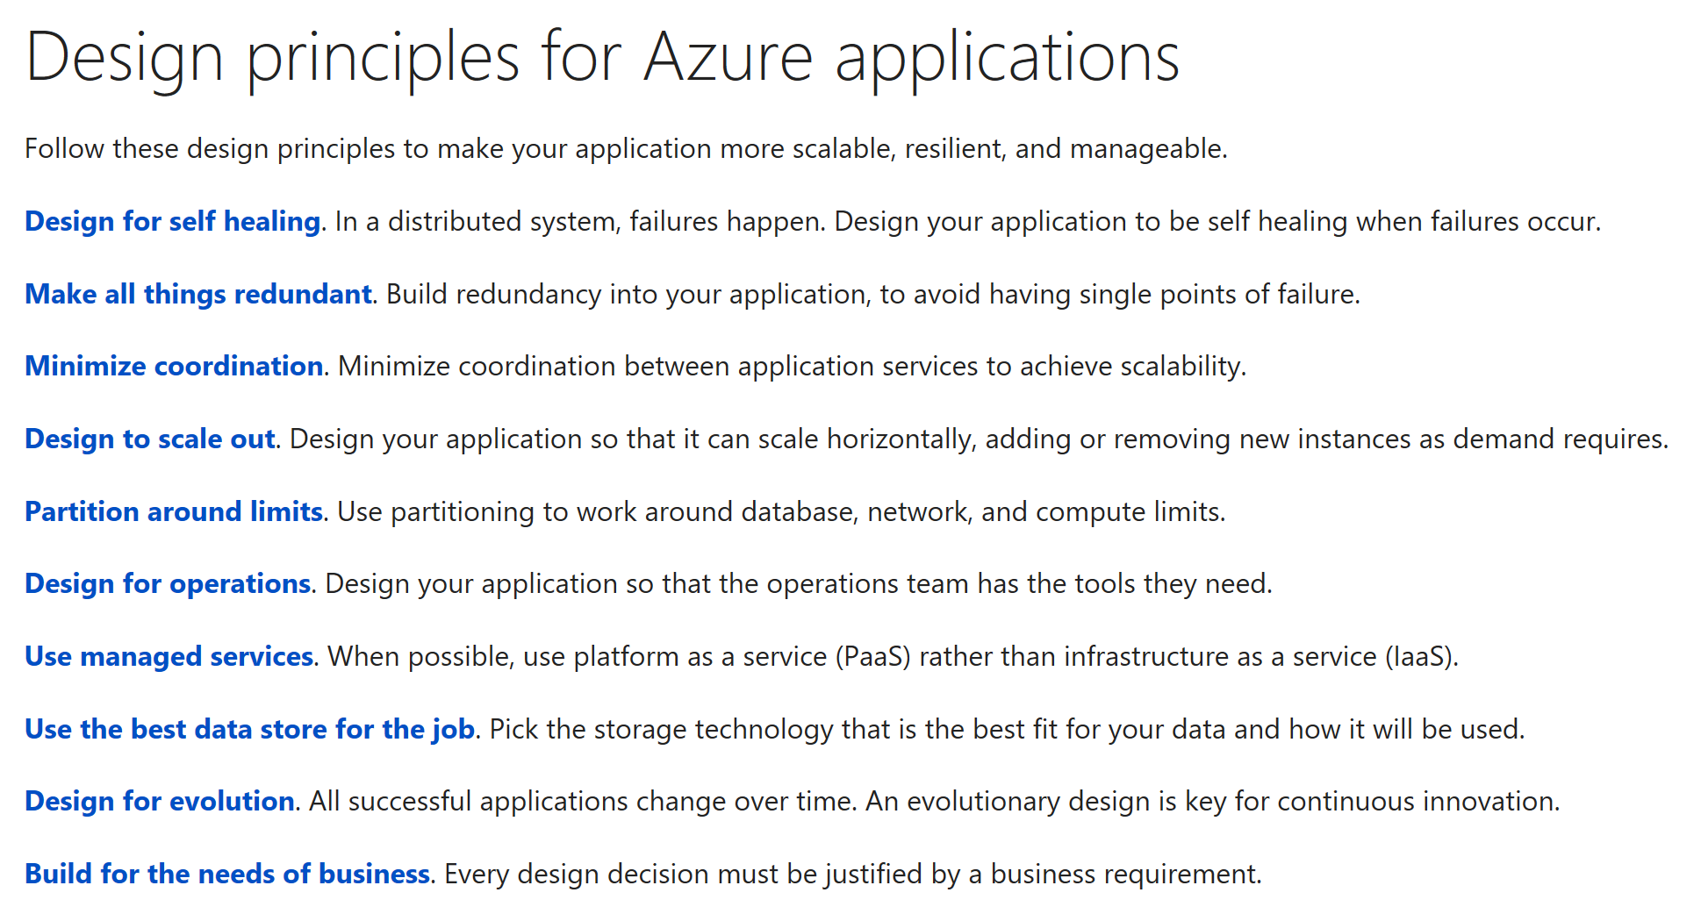

Slide 4
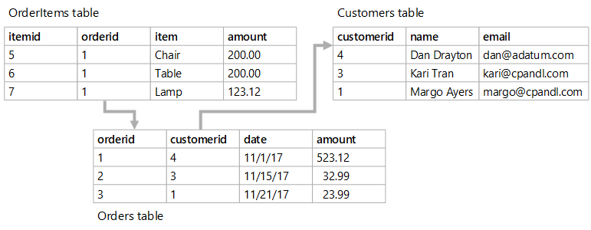
Relational Databases
Relational data is data whose model is based upon the relational model of data whereby all data is expressed as tuples, and the tuples are grouped into relations. A data store that organizes data in terms of the relational model is referred to as a relational database. Relational databases use a tabular structure to materialize the relational model- that is they expose all the data as rows in a table with a defined schema consisting of columns. Each column defines a name an a data type for all values stored in that column across all rows in the table.

Slide 5
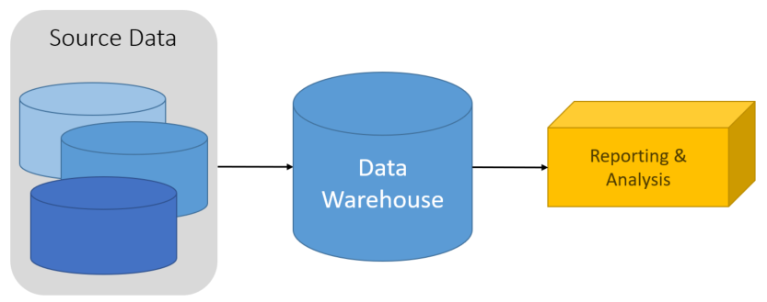
What About a DW?
A data warehouse is a central organizational, relational repository of integrated data from one or more disparate sources, across many or all subject areas. Data warehouses store current and historical data and are used for reporting and analysis of the data in different ways.
To move data into a data warehouse, it is extracted on a periodic basis from various sources that contain important business information. As the data is moved, it is formatted, cleaned, validated, summarized, and reorganized. It becomes a permanent storage space for data used for reporting, analysis, and forming important business decisions using business intelligence (BI) tools.

Slide 6
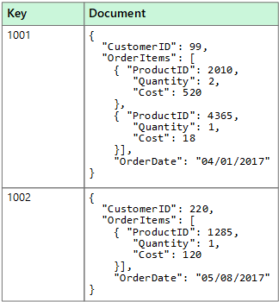
Non-Relational Document Database
A document data store manages a set of named string fields and object data values in an entity referred to as a document. The term "document" refers to the fact that these data stores typcially store their data in the form of JSON documents. Each field value could be simple scalar item or a compound element, such as a list or a parent-child collection. The data in the fields of a document can be encoded in a variety of ways, including XML, YAML, JSON, BSON,or even stored as plain text.

Slide 7
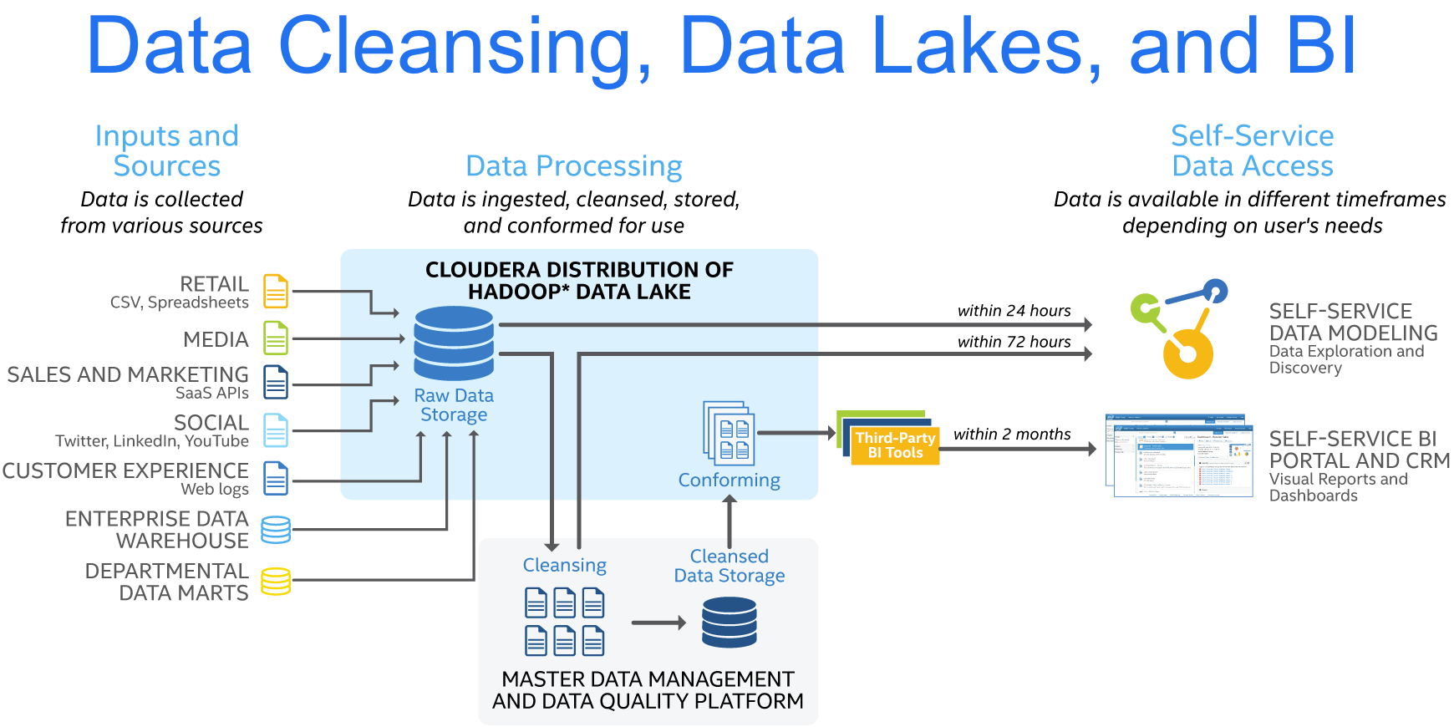

Intel’s POV on Data Quality Outside Hadoop
Conventional wisdom moves data out of the cluster for Data Quality and MDM
Costly process in time and money
Does not take advantage of scalable cluster processing

Slide 8
RedPoint and YARN
Hadoop 1: Based on Map Reduce
Hadoop 2: Based on YARN
MAP REDUCE
Cluster resource management and data processing
Direct
Java .NET
Scripting
Pig
SQL
Hive
Cascading
Scala
Java
NoSQL
HBase
Accumulo
Stream
Storm
Spark Other ISV
API
Other
ISV
Other
ISV
Engine
Batch Map Reduce
Batch & Interactive Tez
Real-time Slider
HDFS
Redundant, reliable storage
YARN: Data Operating System
System
HDFS (Hadoop Distributed File System)
Notes:
YARN is the key for RedPoint Data Management being able to do this all in Hadoop,
YARN stands for yet another resource negotiator, and provides a data operating system, essentially sitting atop HDFS.
In Hadoop 1, we were limited to MapReduce and Pig for getting into HDFS and doing processing. With Hadoop 2, everything including MapReduce goes through YARN at either an API or Engine level.
A very high % of the tools that work through YARN do it via the API level.
However, if you can speak Native YARN, you can write an Application Master (AM) and YARN will instantiate all the core engines of your AM to run in Hadoop just as MapReduce does.
Without an Application Master (AM) it’s not Native YARN, and coding will be involved.

Slide 9


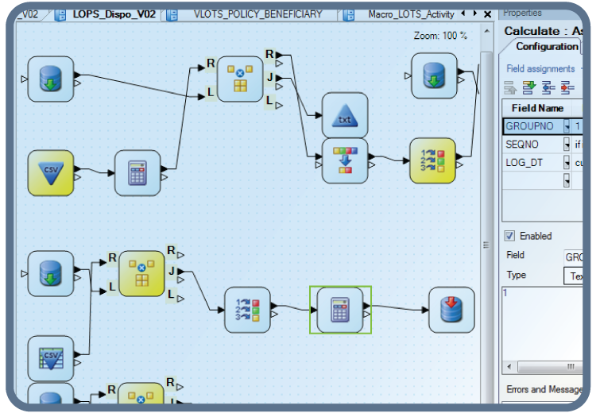
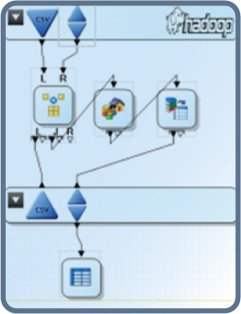
RedPoint DM for Hadoop: Processing Flow
Data Management Designer
2
Node Manager
1
Launches DM App Master
DM Execution Server
Resource Manager
DM App Master
DM Task
Parallel Section
Node Manager
3
DM Task
DM Task
Launches
Tasks
Node Manager
DM Task
DM Task
Running DM Task

Slide 10

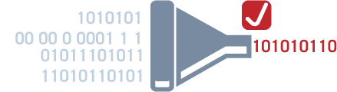
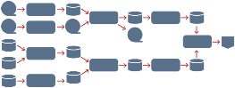
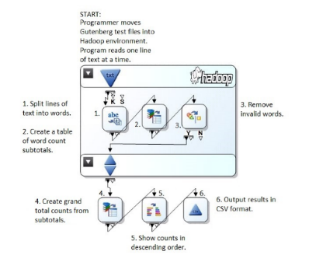
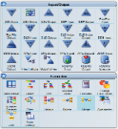
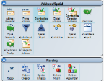
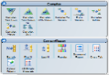
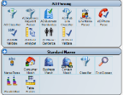
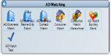
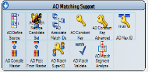

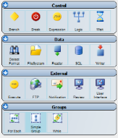
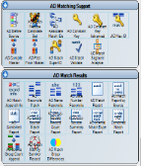
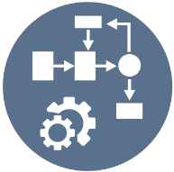
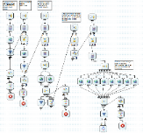

Key Data Mastering Features of RedPoint Convergent Marketing Platform™
ETL & ELT
Data Quality
Integration & Matching
Integration & Matching
Profiling, reads/writes, transformations
Single project for all jobs
Cleanse data
Parsing, correction
Geo-spatial analysis
Grouping
Fuzzy match
Pure YARN integration into Hadoop
No coding data quality
Master Key Management
Web Services Integration
Process Automation & Operations
Process Automation & Operations
Create keys
Track changes
Maintain matches over time
Consume and publish
HTTP/HTTPS protocols
XML/JSON/SOAP formats
Job scheduling, monitoring, notifications
Central point of control
Meta Data Management
Java SDK for rapid development
Public project incubator for project sharing

Slide 11
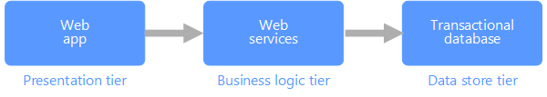
Transactional Data
Requirement | Description
Normalization: | Highly normalized
Schema: | Schema on write, strongly enforced
Consistency: | Strong consistency, ACID guarantees
Integrity: | High integrity
Uses Transactions: | Yes
Locking Strategy: | Pessimistic or Optimistic
Updateable: | Yes
Appendable: | Yes
Workload: | Heavy writes, moderate reads
Indexing: | Primary and secondary indexes
Datum size: | Small to medium sized
Model: | Relational
Data shape: | Tabular
Query flexibility: | Highly flexible
Scale: | Small (MB's) to Large (a few TB's)

Slide 12

Machine Learning
Supervised Learning: In a supervised learning model, the source data consists of a set of feature data fields that have a mathematical relationship with one or more label data fields. During the training phase of the machine learning process, the data set includes both features and known labels, and an algorithm is applied to fit a function that operates on the features to calculate the corresponding label predictions.
Unsupervised Learning: In an unsupervised learning model, the training data does not include known label values. Instead, the algorithm makes its predictions based on its first exposure to the data. The most common form of unsupervised learning is clustering, where the algorithm determines the best way to split the data into into a specified number of clusters based on statistical similarities in the features. In clustering, the predicted outcome is the cluster number to which the input features belong.

Slide 13
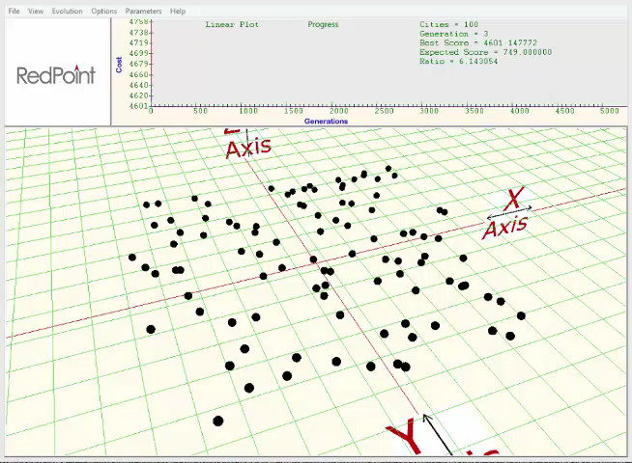
A Simple Example of Optimization

Slide 14
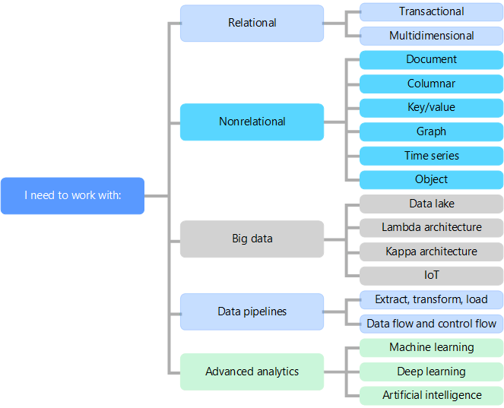
Working with Data Means Picking the Right Technology

Slide 15










Lambda on Azure Data Options
Information Management
Big Data Stores
Machine Learning
& Analytics
Data Consumption
Data Generation
Batch Layer (Cold Path)
Serving Layer
Azure Data Factory
Azure ML
Data Science VM
Databases
Azure Data Lake
Azure SQL Data Warehouse
Ad Hoc Dashboards
R
Power BI
Cortana
Web App
Excel
Perceptual
Intelligence
Azure Import/Export Svc
Spark
Pig
Azure Blob Storage
HDFS
Hadoop Interface
Apps
Hive
HBase
Automated Systems
Business
Custom
HDInsight Sqoop
Mahout
APIs
Business Scenarios
Speed Layer (Hot Path)
Power BI
Azure Event Hub
Azure Stream
Analytics
Big Data Sources
Devices
Azure SQL
DB
Azure
Web App
Crawlers
Storm
Bots
Kafka
Document
DB
Hadoop
Streaming
Interface
Sensors
Spark
Streaming
Redis Cache
Legend
 | Azure |  | Cold Path
 | OSS on Azure |  | Hot Path

Slide 16
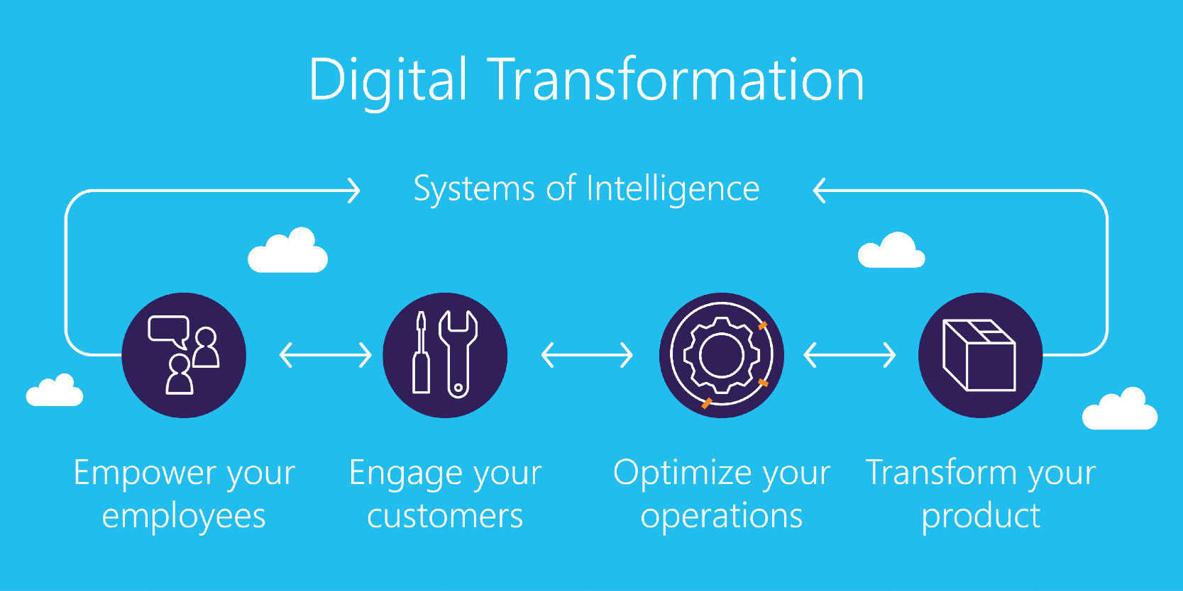
The Microsoft Digital Transformation POV

Slide 17
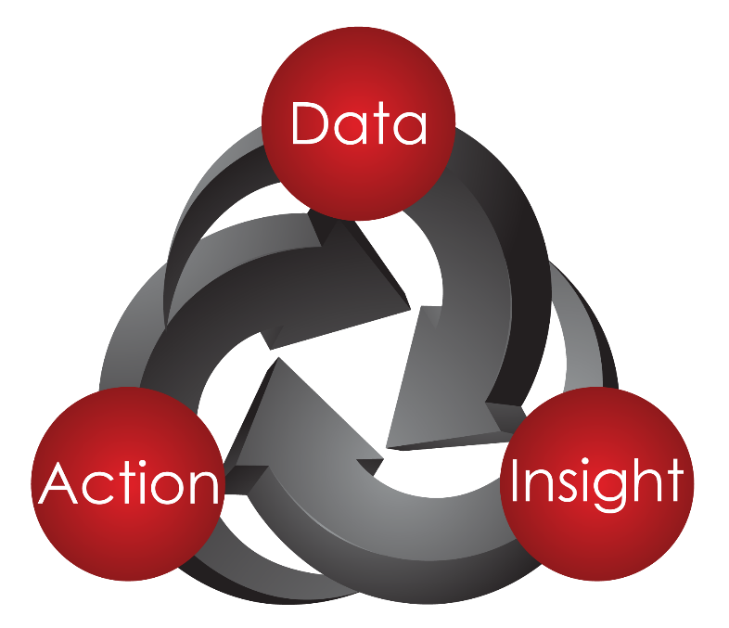
Turning Theory into a Solution

Slide 18



Optimize customer engagement across the enterprise
Optimized Customer Engagement
Marketing
Product / IoT
eCommerce
Sales /
CRM
Service /
Support
Real-time Continuous Integration
RedPoint provides a Customer Engagement Hub with:
API Interconnectivity
Intelligent Orchestration
Execute a coherent brand promise
Output = Personalized Engagement
Intelligent Orchestration
In-Line Analytics
Generate goal-based decisions
Output = Next-Best Actions
In-Line Analytics
Connected Data
Create a dynamic view of the customer across all data sources and types
Output = Golden Record
Customer Data Platform

Slide 19




Real Time Capability Pyramid
Enterprise REAL-TIME (Synchronous) Interactions
Digital Interactions
Rewards
Paper Mail
SMS or Push
Email
Retail
PoS
Batch
Analytics
Data

Slide 20
Perspective on Real Time Decisions
Enterprise engagement technology that delivers contextually relevant experiences, value, and utility at the appropriate moment in the customer life cycle via preferred customer touchpoints.”
Recognition
Identity resolution at a personalized, individual level
Context
History merged with real-time contextual insight
Decision
Analytics to determine action, offer, content, or message
Orchestration
Delivery and dialog management at the appropriate touchpoint
Optimization
Insights for ongoing interactions and strategic planning
Source: February 20, 2015, “Brief: Demystifying Real-Time Interaction Management” Forrester report

Slide 21
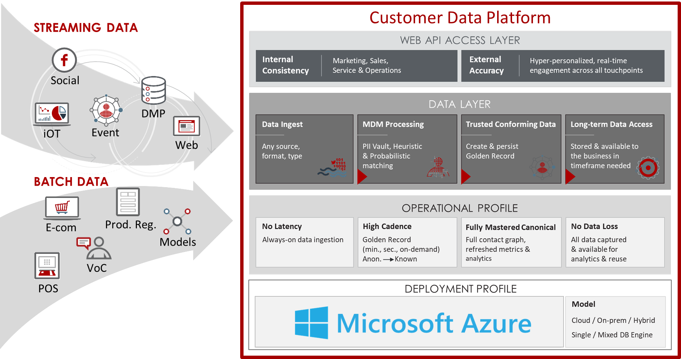
The Customer Data Platform (CDP)
Notes:
Outlined in red are vendors with which we already have partnerships

Slide 22








The Golden Record
WEB API ACCESS LAYER
Physical
Mailing address, Physical address
STREAMING DATA
Household
Family Unit
Social
Golden Record
DMP
iOT
Event
E-Commerce
Personal email, Business email, Junk email, Web Browse
Web
Device
SMS, EMEI, Application, Telephone, IoT
Social
Twitter, Pinterest, LinkedIn, YouTube
Product Registration
Transactional
Purchase history, Return history, RFM , Model Scores
E-com
Models
VoC
OPERATIONAL PROFILE
POS
No Latency
High Cadence
Fully Mastered Canonical
No Data Loss
Always-on data ingestion
On-demand, Seconds, Minutes
Anon. Known
All data captured & available for analytics & reuse
BATCH DATA
Full contact graph, refreshed metrics & analytics
© RedPoint Global Inc. 2017
Confidential
Notes:
And drill down to core of CDP, which is Golden Record:
Grab all data of customer to create view
Enable to bring sources in – streamline or fetched
Bring into platform – all the different sources in 2 ways get brought in.
---
Web api access layer: internal & external
This is the most valuable thing the customer looks at
How do you provide the open arch to make this available with internal and external customers
---
Most valuable piece is the middle (that’s the platform)
Ingestion > any source, locate it all
Data Quality & match > match data to persons life
ID Resolution > realizing that customer is 1 person, based on all the different pieces of info
Data Accessibility> utility (always available, as you need it) accessinle to everyone in the time they need it
---
Operational Profile
Outlined in red are vendors with which we already have partnerships

Slide 23

INITIATIVE
It was a strategic imperative for this CPG provider to drive revenue for consumable, add-on products. This required them to overcome the friction and fragmented experience caused by silo’d data, business rules and analytics spread across 17 different systems of engagement. They also needed to future proof the investment to connect with future Internet of Things (IoT) devices.
CONSUMER PACKAGED GOODS (CPG)
CHALLENGES SOLVED
Engage with customers to create hyper-personalized 1:1 connections
Deploy the solution quickly to meet holiday season goals and constraints
Deliver offers that drive on-line versus in-store product purchases to increase profit margins
Convert, retain and grow customer LTV across channels by better understanding preferences and behaviors
Measure activity and results across customer engagement systems in real-time

Slide 24
SOLUTIONS
Customer Engagement Hub (Connected Data, In-line Analytics, Intelligent Orchestration)
Integrated 25 sources of data across the enterprise and created an enterprise wide Golden Record, making it possible to cost effectively append an additional 300 attributes to gain deep understanding of customer behavior and preferences, and leverage it in real-time
Implemented real-time decisions, including deploying a product recommendation engine that consistently delivers offers no matter where the customer appears next
CONSUMER PACKAGED GOODS (CPG)
RESULTS
REVENUE Hit stretch goals for new offers deployed in holiday season
GROWTH in net-new customers
INCREASE in order frequency and number of products
144% LIFT in average order revenue over previous baseline
SPEED TO VALUE went from design to operations in 15 weeks

Slide 25
RedPoint’s Customer Data Platform Approach
Channels
Keurig.com
Email
Phone
Connected
DMP
Data Sources
Streaming Data
Media
Customer Data Platform
Data Consumers
IBM DA
Direct Response
DMP, Krux
360° Customer View, Master Customer Profile
Data Management Platform, Krux
Connected Brewer, Ayla
Keurig.com, Clickstream
Mulesoft, API Gateway
Reporting and Visualization
Batch-processed Data
IoT
CMS, Hybris
Keurig Retail Stores
Statistical Modeling, Machine Learning
[Media, MediaVest]
Transactions
Eversight, Foresee
VOC, Foresee
Ad-hoc Analysis
Hybris Transactions
Consumer Feedback
KQUP, Brewer Registration
Rules Engine, Alerts, Threshold
Customer Care, Siebel
Optimization: Monetate
Customers
BazaarVoice
Product, Price and Inventory
Data Management, Internalization
Catalog, Product and Price
API Gateway, MuleSoft
Siebel, Customer Care
POS and Retail Sales
Storage and Processing
Price Optimization: Eversight
CMDB
Monetate
Workflow: Screen Dragon
3rd Party
Experian: QAS
Tealium
Keurig Users
PR
Quality
Marketing
Digital
Category
Business Analytics
Customer Care
Connected Brewer
Finance

Slide 26

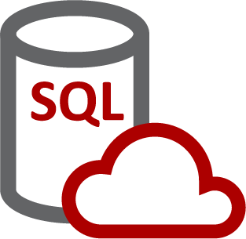














Sample CDP/Digital Architecture
Session Data, Real Time Decision Support
SQL DW
Azure Redis Cache
Machine Learning
Azure Active Directory
DevOps Services
Availability Set (Scale Up & Out)
VM
VM
Firewall
VM
Hosted Web Sites
Campaign Interaction
Campaign Interaction
Decision Optimization (M/L)
AD DC Availability Set
Azure Files
Web Site(s)
5 x Small
SQL Meta-Data Databases
VM
VM
VM
sFTP Server
Firewall
AD DC Replica
AD DC Replica
RT Decisions
Dynamic Lading Page Sites, Unique Operations (if needed)
Dynamic Lading Page Sites, Unique Operations (if needed)
Data Ingestion Availability Set
VM
VM
VM
Hadoop Cluster All Raw and Processed Data
Remote App Session Host
Data Management SiteServer?
Data Management SiteServer?
Stream Analytics
Event Hub Krux
Device Data
Access and Endpoints Control
Virtual Network
VM
CDP Users

Slide 27
INITIATIVE
Leading internet-based technology and business services provider is taking the next leap forward in personalizing engagement with millions of small and medium-sized enterprises (SME). Strategic goals include higher conversions, attach rates and average deal size through smarter cross-sell and upsell to prospects and customers. They wil leverage a wide variety of data (e.g. ecommerce, customer web behavior) in real-time to drive advanced analytic models and engagement across all digital and traditional channels. This includes a strong use of call center agents to better engage their customers with specific, highly personalized product recommendations in the actual moment of engagement.
TECHNOLOGY & BUSINESS SERVICES
CHALLENGES SOLVED
Deploy a customer engagement platform that enables them to:
Tap into the digital transformation wave, enabling consumers to educate themselves across all digital channels including brand website and 3rd party sites, peer discussions on their products in social network forums leading to conversion and the purchase transaction through the brand’s digital platforms
Enable customer engagement systems to deliver a branded customer experience that’s far better than the competition, as a strategic differentiator in driving conversions and retention
Conduct highly personalized, real-time engagement with high contextual relevance, and deliver it consistently across all digital channels and traditional channels such as call center

Slide 28
SOLUTIONS
Customer Engagement Hub (Connected Data, In-line Analytics, Intelligent Orchestration)
Consolidate all customer data sources and types (structured & unstructured, batch and streaming) into a unified view of a customer via an always on, and always processing Golden Record
Synthesize Identities (known and unknown) to allow marketing to engage prospects across channels and devices while keeping within compliance and preference guardrails
Utilize real-time identity resolution, real-time analytics and optimization, as well as real-time decisions to deliver content, messages and offers to the customer, no matter their interaction touchpoint
Leverage machine learning and real-time decisioning to hyper-personalize content (including sales and non-sales content) to activate execution of personalized interactions in an automated, always-on fashion across all channels and touchpoints
TECHNOLOGY & BUSINESS SERVICES
RESULTS
SPEED Deliver highly personalized product recommendation within a 60-millisecond window
DIFFERENTIATION Increase audience size through awareness, brand perception, consideration of provider as THE go-to digital partner for small business
ALIGNMENT WITH PREFERENCES Broaden the type & delivery methods for communications to reflect the preferences of the customer
CONVERSION Improve conversion rates from brand awareness to discovery/consideration to purchase
EXPANSION Increase attach rates and average deal size thru smarter cross sell and upsell programs
RESOURCE UTILIZATION Streamline activities, operational efficiencies and reduced labor costs (internal and external)
LIFETIME VALUE Increase penetration into existing customer base to grow a larger share of wallet and higher customer lifetime value

Slide 29
Sample CDP/Digital Architecture
Persistent Data stored in high speed Cassandra
VM
Session Data, Real Time Decision Support
SQL DW
Azure Redis Cache
Machine Learning
Azure Active Directory
DevOps Services
Availability Set (Scale Up & Out)
VM
VM
Firewall
VM
Hosted Web Sites
Campaign Interaction
Campaign Interaction
Decision Optimization (M/L)
AD DC Availability Set
Azure Files
Web Site(s)
5 x Small
SQL Meta-Data Databases
VM
VM
VM
sFTP Server
Firewall
AD DC Replica
AD DC Replica
RT Decisions
Dynamic Lading Page Sites, Unique Operations (if needed)
Dynamic Lading Page Sites, Unique Operations (if needed)
Data Ingestion Availability Set
VM
VM
VM
Hadoop Cluster All Raw and Processed Data
Remote App Session Host
Data Management SiteServer?
Data Management SiteServer?
Stream Analytics
Event Hub Krux
Device Data
Access and Endpoints Control
Virtual Network
VM
CDP Users

Slide 30
https://docs.microsoft.com/en-us/azure/architecture/

Slide 31




RedPoint MDM – What we are delivering
POINTS OF ENGAGEMENT
Call Center
eCommerce
Email
Web
Mobile
Social
iOT
. . .
SOURCE SYSTEMS
Data Stewards
SS1
|
|
|
|
SSn
“Customer”
Party Data
Automated
Data Quality,
Match and Merge,
3rd Party Data Enrichment, and
ETL
“Product”
Product Data
Master Data Hub
Marketing Operational Database
“Device”
Thing Data
Engagement Management
REFERENCE DATA
OUTBOUND SYSTEMS
RD1
|
|
|
|
RDn
EDW
OBS1
|
|
|
|
OBSn
ODS
Master data and transactional data linkage
Transaction Data
Purchase History
Notes:
So circling back to what we discussed around MDM last year, here’s a picture of what we are delivering, in the context of some business use cases for the MDM capability and the customer record.

